Slide 1
ABSTRACT EXPRESSIONISM
History of Modern Art
BFA-III (Visual Arts)
Course Incharge: Ms. Sidra Liaqat
Institute of Design & Visual Arts, LCWU

Slide 2
Types of Abstract Expressionism
Within Abstract Expressionism were two broad groupings:
Gestural Expression or Action Painting relied on the expressiveness of energetically applied pigment. These artists attacked their canvases with expressive brush strokes;
Chromatic Abstraction or Color Field Painting focused on color’s emotional resonance. These artists filled their canvases with large areas of a single color.

Slide 3
Arshile Gorky
(1904–1948)
American
The most important fore-runner of the Abstract Expressionists was an Armenian immigrant who arrived in New York in 1924, Arshile Gorky. His work is the bridge between the Biomorphic Surrealism of Joan Miro and the totally abstract canvases of Jackson Pollock.

Slide 4
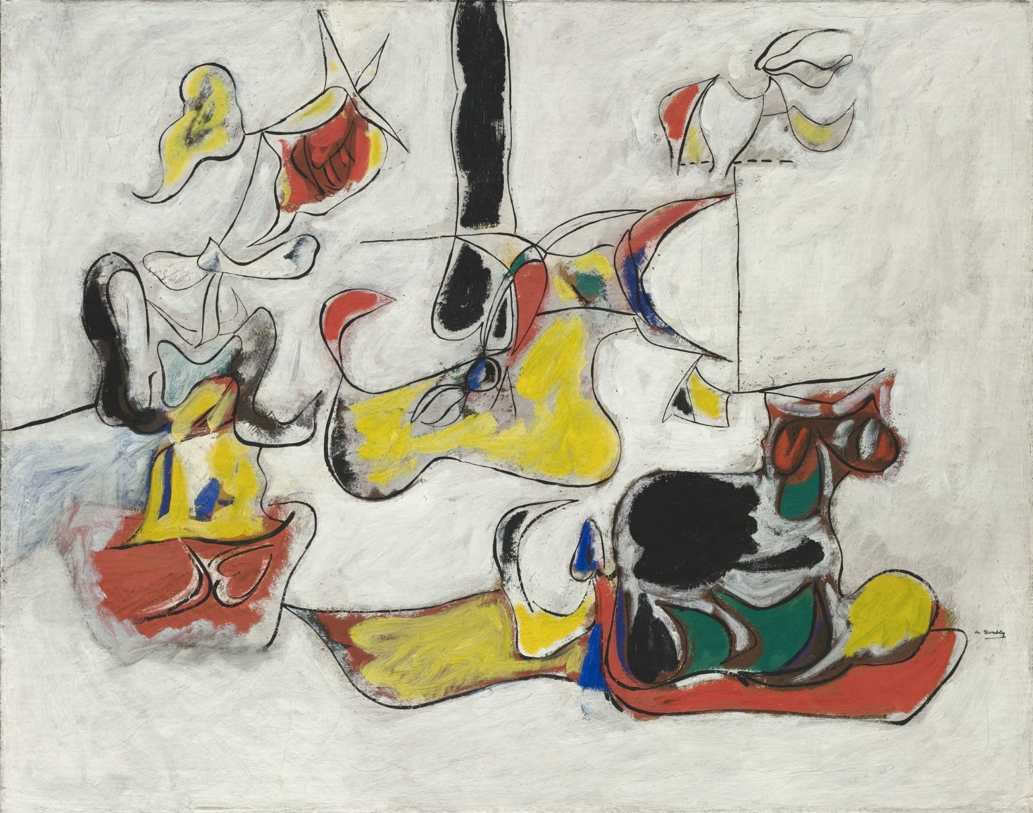
ARSHILE GORKY
“Garden in Sochi” Oil on Canvas
(1943)

Slide 5
Jackson Pollock
(1912-1956)
American

Slide 6
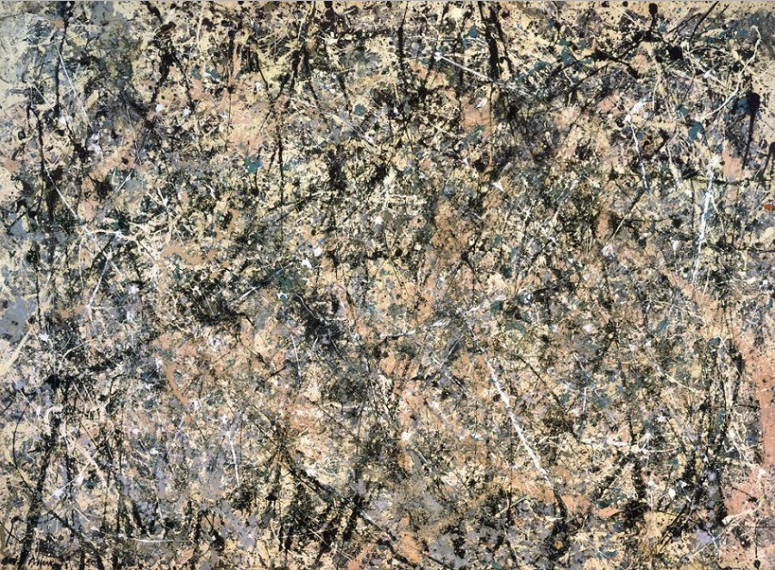
JACKSON POLLOCK
“Number 1” (Lavender Mist)
Oil, Enamel & Aluminum Paint on Canvas
(1950)

Slide 7
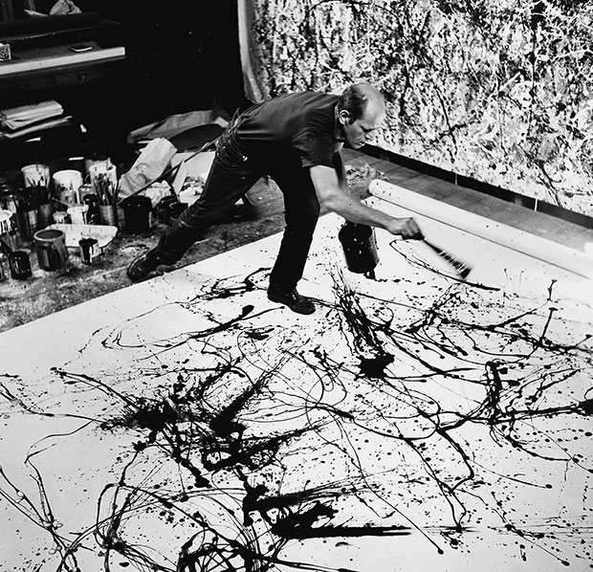

Slide 8
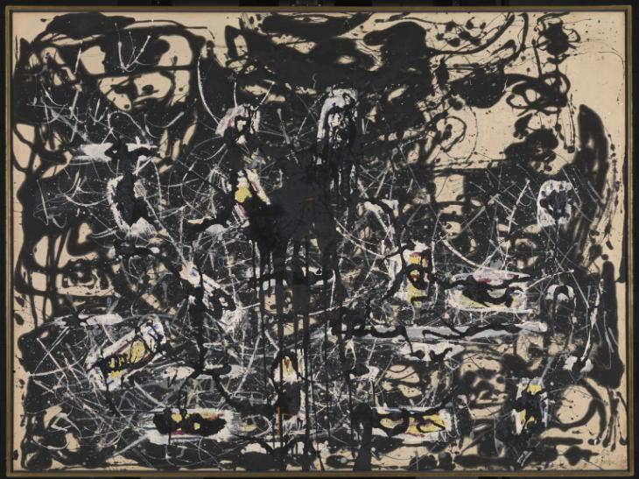
JACKSON POLLOCK
“Yellow Islands” (1952)

Slide 9
Willem De Kooning
(1904–1997)
Dutch-American

Slide 10
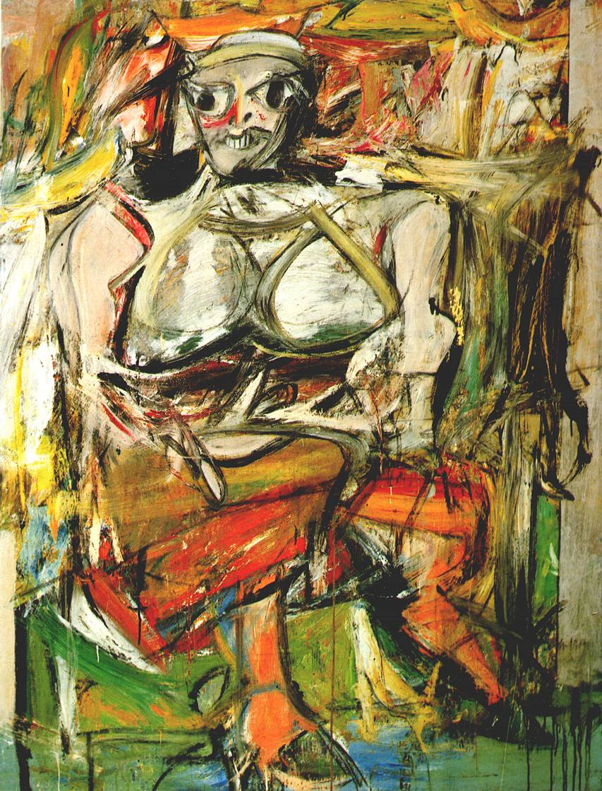
WILLEM DE KOONING
“Woman I”
Oil on Canvas
(1952)

Slide 11
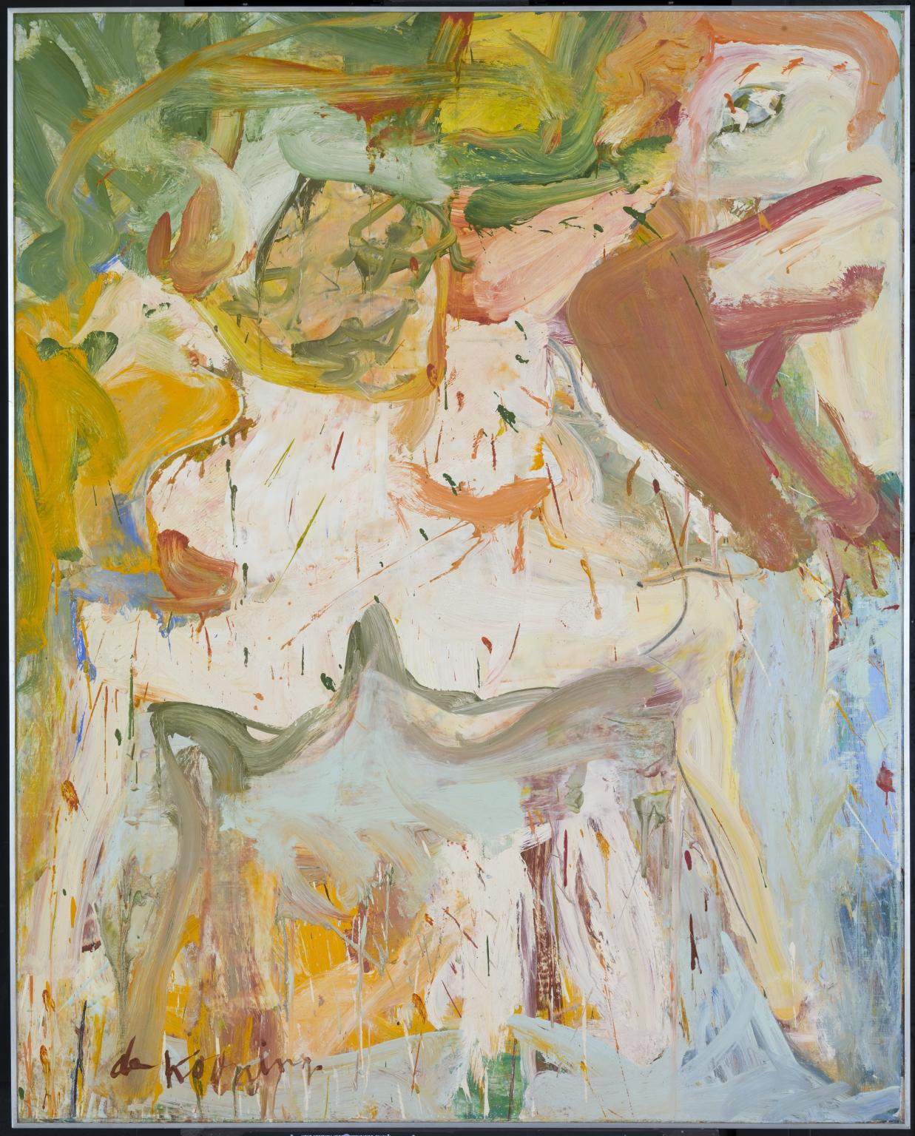
WILLEM DE KOONING
“The Visit”
Oil on Canvas
(1967)

Slide 12
Joan Mitchell
(1925-1992)
American

Slide 13
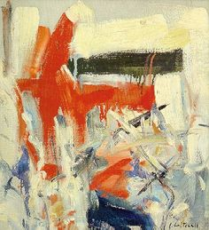
JOAN MITCHELL
“Untitled”
Oil on Canvas
(1955)

Slide 14
Barnett Newman
(1905-1970)
American painter

Slide 15
BARNETT NEWMAN
“Sublime Heroic Man”
Oil on Canvas
(1951)

Slide 16
Mark Rothko
(1903-1970)
American painter with Russian Jewish descent

Slide 17
MARK ROTHKO
“No. 14”
Oil on Canvas
(1960)

Slide 18
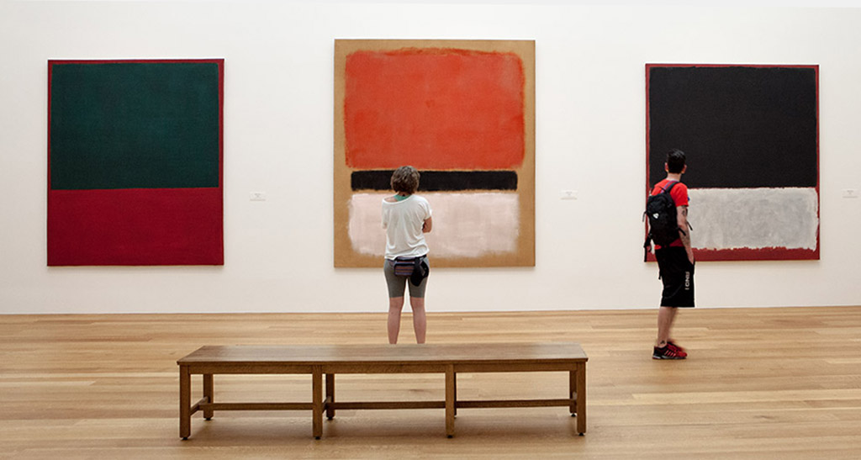

Slide 19
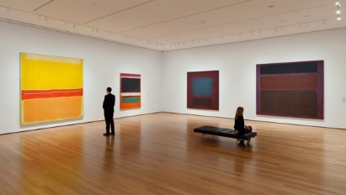

Slide 20
David Smith
(1906-1965)
American sculptor

Slide 21
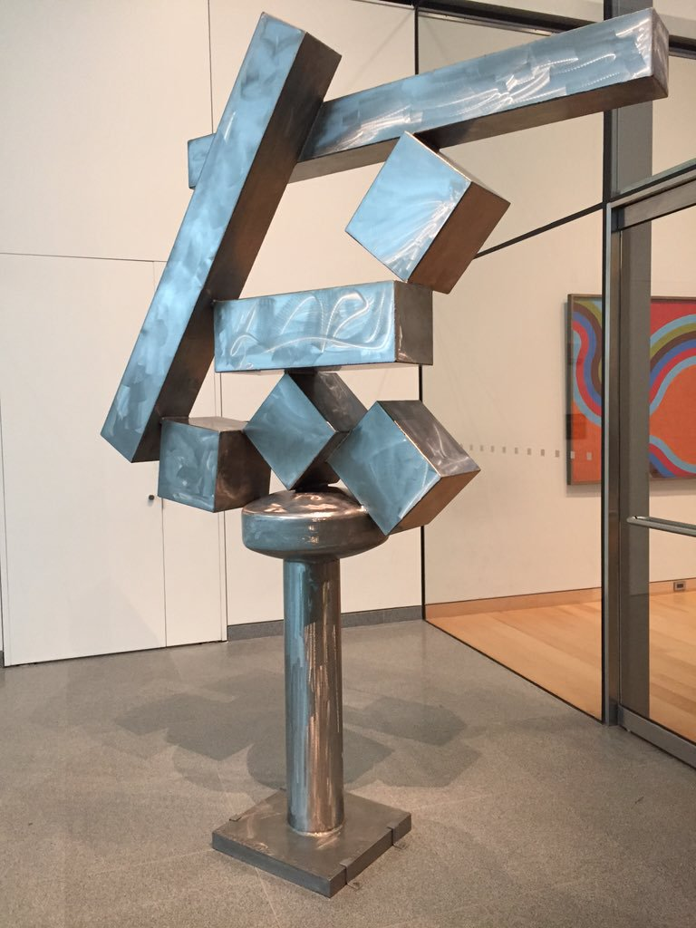
DAVID SMITH
“Cubi XIII” (from the series of 28 Cubi)
Stainless Steel
(1964)

